Slide 1

“Social Protection Finance for a changing World of Work - Key Considerations For A Responsive Financing Framework For Social Protection In Africa ”
Mutale Wakunuma
Institute for Social Policy in Africa
Zambia Regional Office
director@instituteforsocialpolicyafrica.com

Slide 2
Outline
01
Contextual Overview
02
Social Protection in the Region
03
Current SP Financing Architecture
04
African Social Protection Context and the future of work
05
What the future should look like

Slide 3
Contextual Overview
Population: 334,166,067
Regional GDP (Simple average): 38,28 $bn (2016)
GDP Per Capita: 1,761$
Gini coefficient: 0.55
Poverty: 43% (2012)
Country | GDP USD bn | Year
Angola | 89,63 | 2016
Botswana | 15,27 | 2016
D. R. Congo | 35 | 2016
Lesotho | 2,2 | 2016
Madagascar | 9,991 | 2016
Malawi | 5,442 | 2016
Mauritius | 12,16 | 2016
Mozambique | 11,01 | 2016
Namibia | 10,27 | 2016
South Africa | 294,8 | 2016
Swaziland | 3,727 | 2016
Seychelles | 1,427 | 2016
Tanzania | 47,43 | 2016
Zambia | 19,55 | 2016
Zimbabwe | 16,29 | 2016

Slide 4
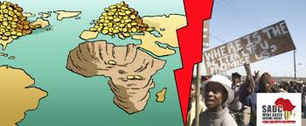
Poverty and Inequality
About 43% of Population is Poor
POVERTY & INEQUALITY
fell from 56% in 1990 to 43% in 2012
Differences between Countries are significant
Nominally, more people poor
about 330mn up from 280 million (Africa)
High Inequality
Rural areas much poorer than urban
Welfare Indicators Poor
income, infrastructure, education, health, and social safety

Slide 5
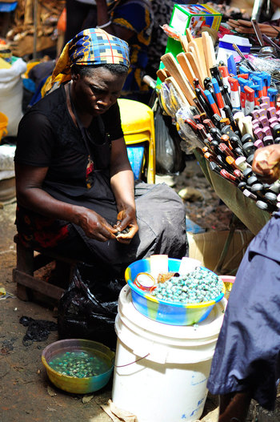
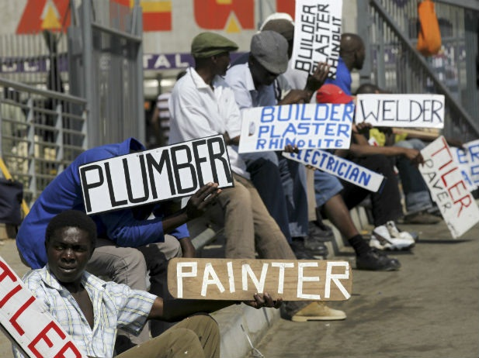
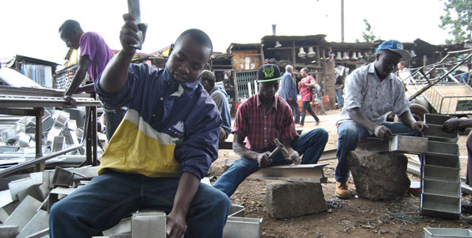
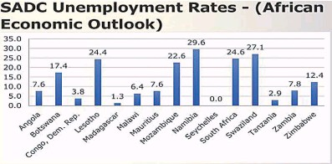
Employment
High levels of unemployment
High levels of informal activity (often more than 90% of the workforce)
Mostly labour intensive
High levels of illiteracy
Highly unskilled labour force

Slide 6
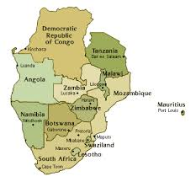
Social Protection in the Region
Characterised by low levels of social protection coverage (6%-20%)
Contributory social security coverage (5%)
Spending on social protection is typically in the region 1.6% of GDP.
Dominant programming is Agricultural subsidy, Cash Transfers and School feeding
Response to poverty and vulnerability and lately inequality
Still fairly dependent on donor funding

Slide 7
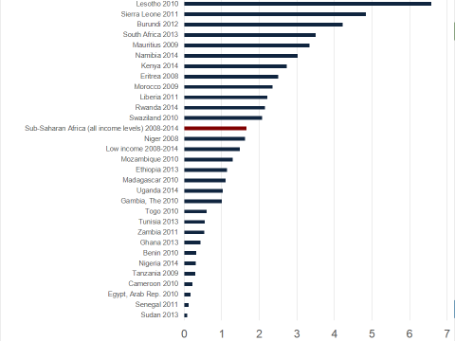
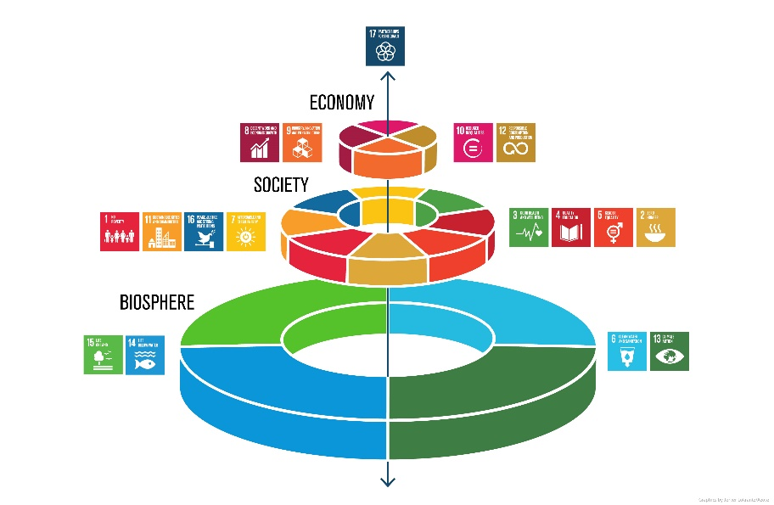
The Current Social Protection Financing Architecture
Historical Perspective, 0.7% of GNI
Price Tag for Sustainable Development 5 to 7 trillion, deficit 2.5 trillion
Challenges with ODA for Social Protection in the SDG Dispensation (peak of $142.6 billion in 2016)
World Bank estimated that between 50 and 80 percent of what’s required will come from domestic resources.
Blended Finance – Social good versus profit

Slide 8
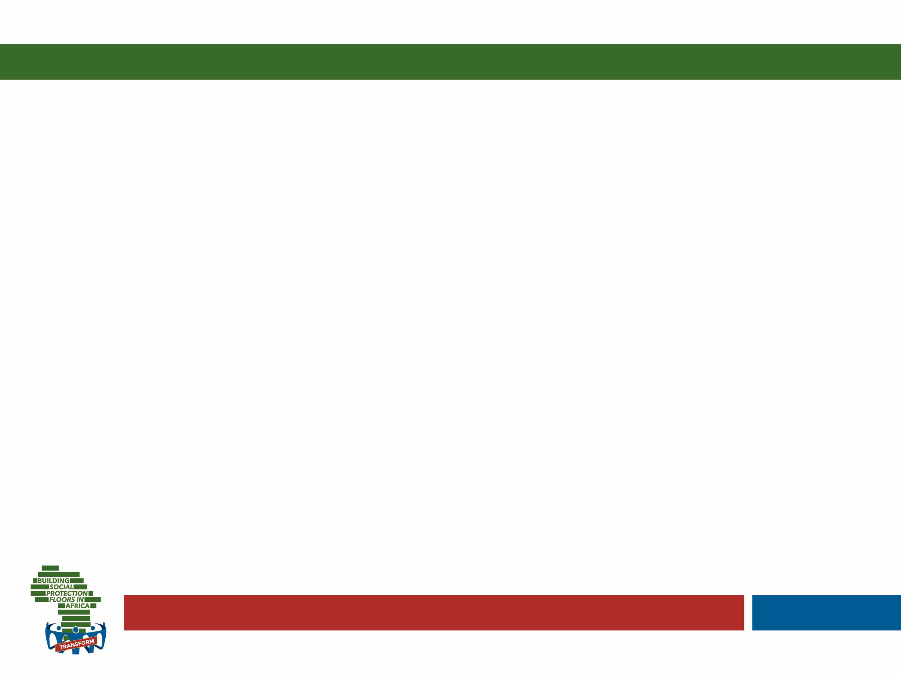
How much do countries spend on SP?
Simple mean of GDP allocated to SP:
On average, 11%.
Weighted by population:
8.4 per cent of the GDP.
In SSA?
1.7% of GDP on average to non- contributory
Notes:
Reflect on these stats.. And how spending is much lower in SSA…

Slide 9


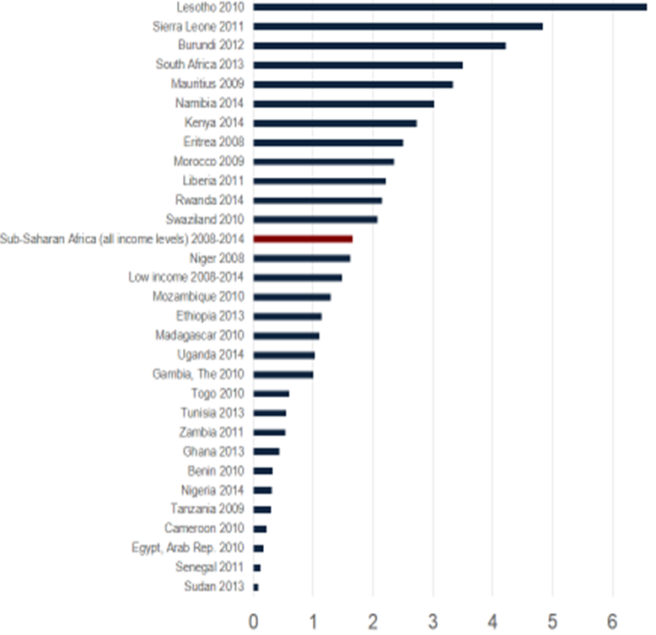
Current Financing Picture
Where it gets Interesting
Banking on Blended Finance and Domestic Resources
ODA
Domestic Resources
Minimally Investing in Social Protection and Banking on ODA

Slide 10
The African Social Protection Context and the future of work
01
02
03
Employment still largely Informal
Social Protection coverage challenges
Financing Gap hugely unresolved
Social Protection
Employment
Financing

Slide 11
Key Considerations for a responsive Social Protection System for the Future of Work
Fiscal Space Expansion
Data Systems
Earmarked taxes or through taxation of natural resource extraction
Data systems will be pivotal to the identification of Social Protection Needs and policy design
Domestic Resourcing
Benefit Portability
Sustainability through increased levels of domestic financing and Legislation
Regulations should be modified and simplified to address the challenges from changes in work.
Restructuring Education
Rethinking Tax
Education system and skills development as a core element of Social Protection provision
Reducing tax reliance on low income earners and curbing tax competition

Slide 12

That’s it!
Thank you for your Attention

